Slide 1
SHOWTOP Technology · Smart Screen Management Platform Introduction
2019 – 03 - 18

Slide 2
PART ONE
Platform Introduction

Slide 3



Platform Management Architecture
Intelligent Interactive extension
Basic Transmission
Third-party Business Integration
Interactive mode
Smart kit
Display terminals
Data channel
Content publishing and processing
Management platform integration
Screen management platform
Scan mode
RGB Cam
Touch mode
Depth Cam
Designer task platform
Picture recognition
Face Detect
E-commerce platform
Face Recog
Distance Sense
User
Mobile
Body Detect
SHOWTOP cloud service
Advertising distribution platform
Object Recog
Code Scan
Beacon
Third party screen interaction
NFC trigger
Mic Array
Voice command trigger
OA management platform
Offline Product
NFC/RFID
Product induction trigger
Played content is uploaded from the web management terminal to the server
……
At this stage of the project, only the transmission function is required. Adopt this system to ensure that the brand will quickly realize new retail upgrades in the future.

Slide 4
Platform Management Content
Basic Messaging function
1
2
3
4
Shop Management
Equipment Management
Content Management
Play Management
Extension Function
5
6
7
E-commerce Management
Interactive Scene Management
Data Management
Note: Purchase the number of extension boxes, that is enjoy all the control functions of the platform, but also the extended function requires front-end configuration of interactive devices.

Slide 5
1
Shop Management

Slide 6
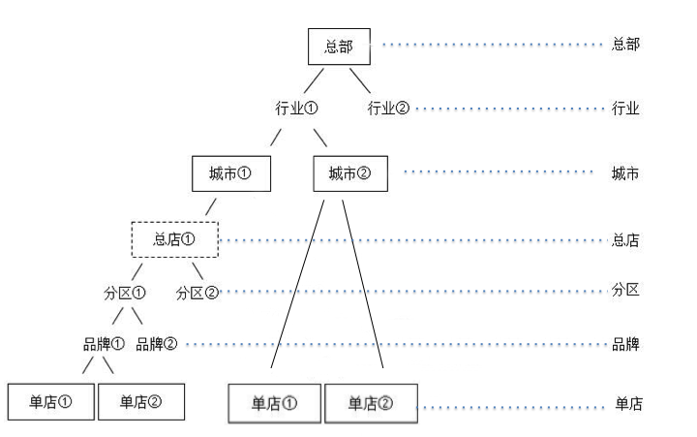
Multi-level Management Authority
Headquarters, branches, and sub-departments can create different user groups and login user accounts.
Support personalized role combinations to set access permissions for different users
Scalable/multi-level management tree structure Headquarters
|-- region
|--City
|-- Head Shop
|-- Shop
|-- Screen
Seven-tier management architecture that seamlessly integrates brand business Thinking

Slide 7
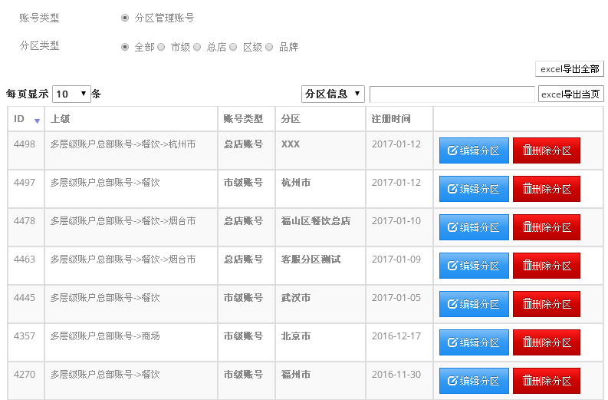
Multi-level Management · Platform Interface
Content delivery for a single screen, or directly to a certain partition, city, etc.

Slide 8
2
Device Management

Slide 9

Multi-class Screen Compatible + Tag Management
Screen Type
Projection and others
Any size LED
LCD/LCD splice
Like PAD Mobile device
Home/commercial display
……
Label Management
Store: Four generations of stores
Brand: Digital extension machine
Location: Explosion area
……
Multi-type screen management issues when fully considering future demand expansion

Slide 10
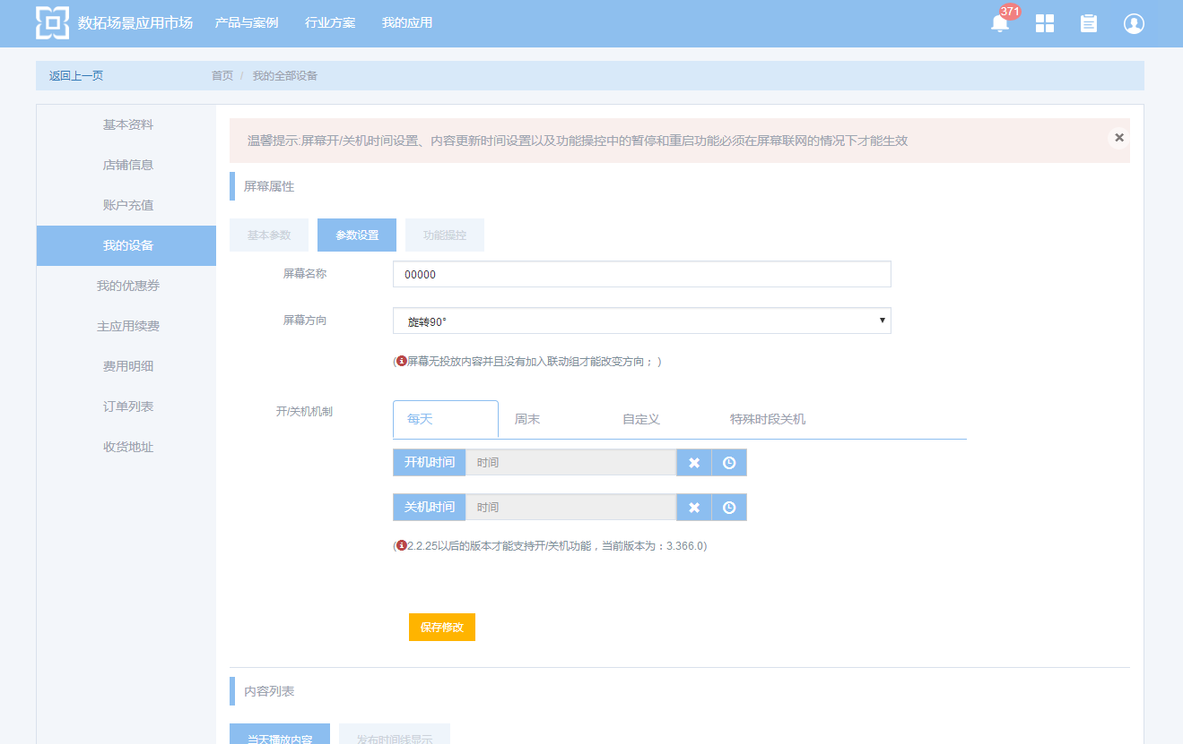
Remote Control
Remote condition monitoring
Network: You can remotely view the operation status of different store screens, network conditions, etc. If ‘Offline’ is displayed, you can promptly check the store to check the network.
Screen capture: You can remotely view the screen to view the content of the screen, helping the merchant to monitor the screen playback status at any time.
Remote function setting
Switch on, restart, timing ： The screen can be controlled and controlled remotely, and the machine can be turned on and off.
Disassemble ： If you do not need to retain the original delivered content, remotely select the disassemble function, that is release the screen serial code, activate the new screen, and delete the original screen content.
Change machine ： If you want to keep the original content, select the 'Change' function, remotely copy the content through the screen ID, you can transplant the original screen content to the new screen. No need to send it over the network again, saving traffic and saving time 。
Remote switch machine, timed play function, only professional version V8 box has

Slide 11
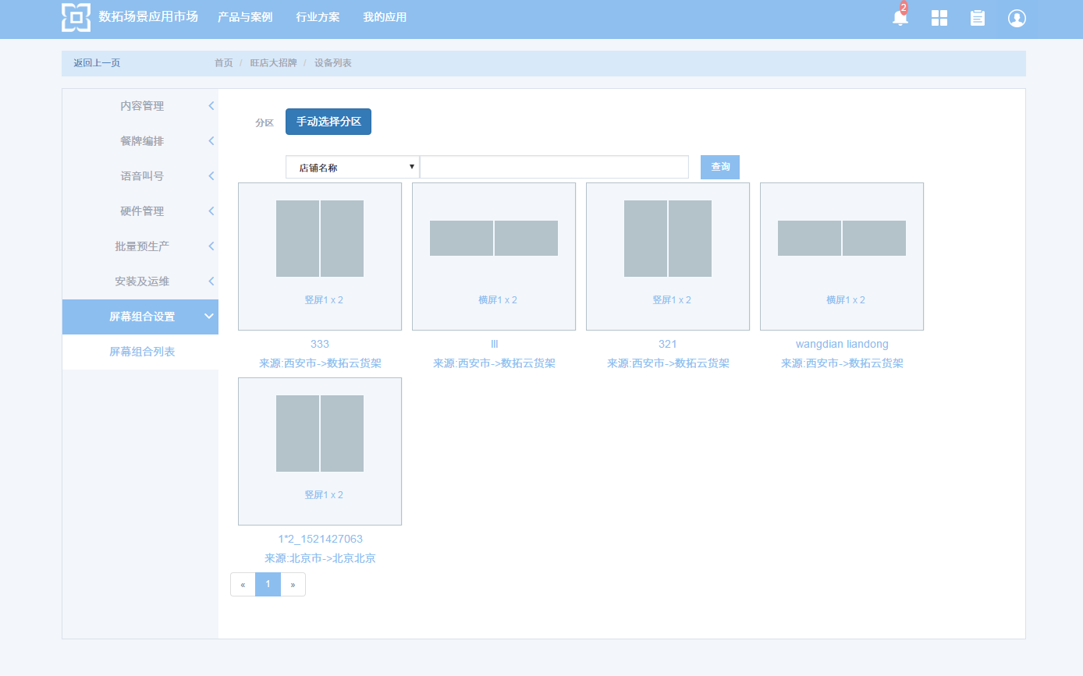
Cross-screen linkage
Linkage setting
Continuously installed screens that can be grouped into stitching groups
The same account can manage the splicing groups installed in different areas. The splicing method is flexible, and the splicing group can be cancelled at any time.
Linkage/single screen switching display
Set timing, which can realize cross-playing of linked content and single-screen content.
Remote switch machine, timed play function that only professional version V8 box has

Slide 12
3
Content Management

Slide 13
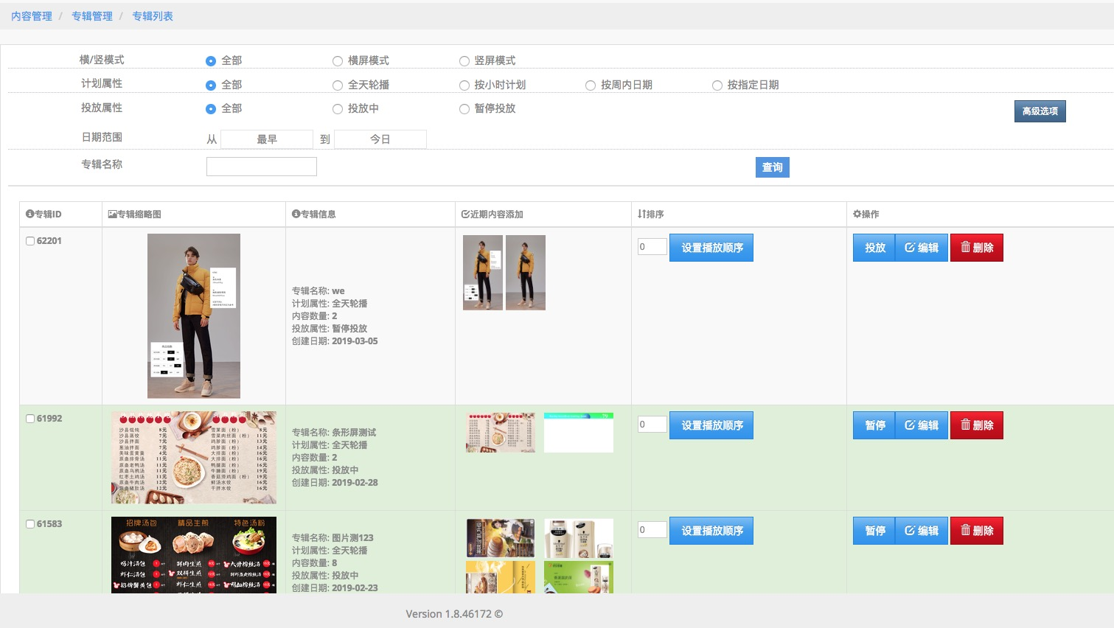
Album Management
Screen auto adaptation
The content can be automatically applied to screen size.
Also can set different sizes of content for different screens.
H5 template (video, photo, animation, etc.)
The H5 template is used as the bearer mode, and the terminal displays multi-layer content, not only simple videos, pictures, etc.;
Dynamic effects stacking, floating, and more can be set.
Multi-content album management
Multiple content can create albums and set labels for albums, enabling one-click placement of multi-content, multi-level screens.
Sub-regional and time-phased delivery
Can use one button to deliver multiple stores with multiple contents, or you can select the placement area according to the level of permissions;
The playback time can be set for the content according to the marketing strategy.

Slide 14
4
Play Management

Slide 15
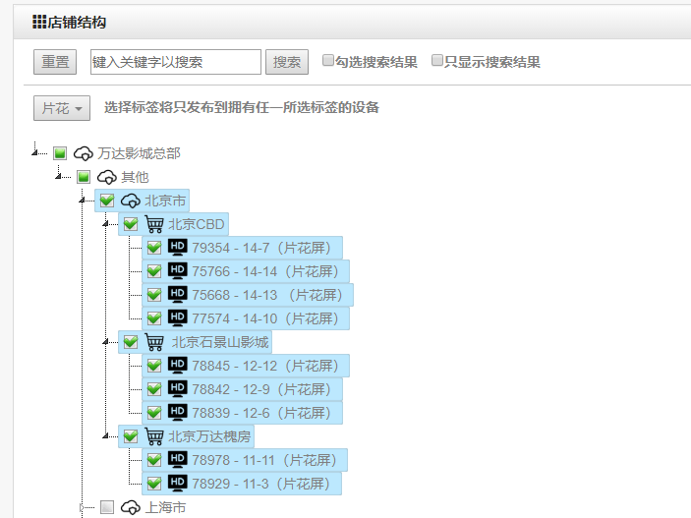
Customize Placement Area
Headquarters unified marketing Manage large screens across the country through the cloud management platform and publish content to all screens with one click.
Sub-regional marketing
You can edit different content to play "album" and freely choose the branch or region to be placed.
Split screen content delivery
The smallest unit for content delivery is the screen, and the same store screen can display different content according to different needs.

Slide 16
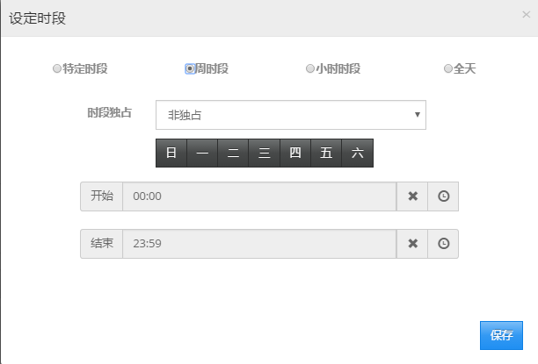
Customize Play Time
Multiple play modes
For the album, set the playback mode (carousel, custom play, exclusive play), the play time can be selected weekly time, hour time
Preset Marketing time
According to the characteristics of the marketing campaign/product, set a specific playing time period to pre-schedule, and the screen automatically switches the content according to the setting period

Slide 17
No/Bad Signal· Emergency Delivery Strategy
1
2
Offline Package Mechanism
Master-slave Mechanism
U disk encryption can be used to download offline packages for content replacement.
Define the store host, download content from the external network to the host; can synchronize the content on the host through the LAN, other screen content, save external network traffic

Slide 18
5
6
7
E-commerce management
Intelligent interaction management
Data management

Slide 19
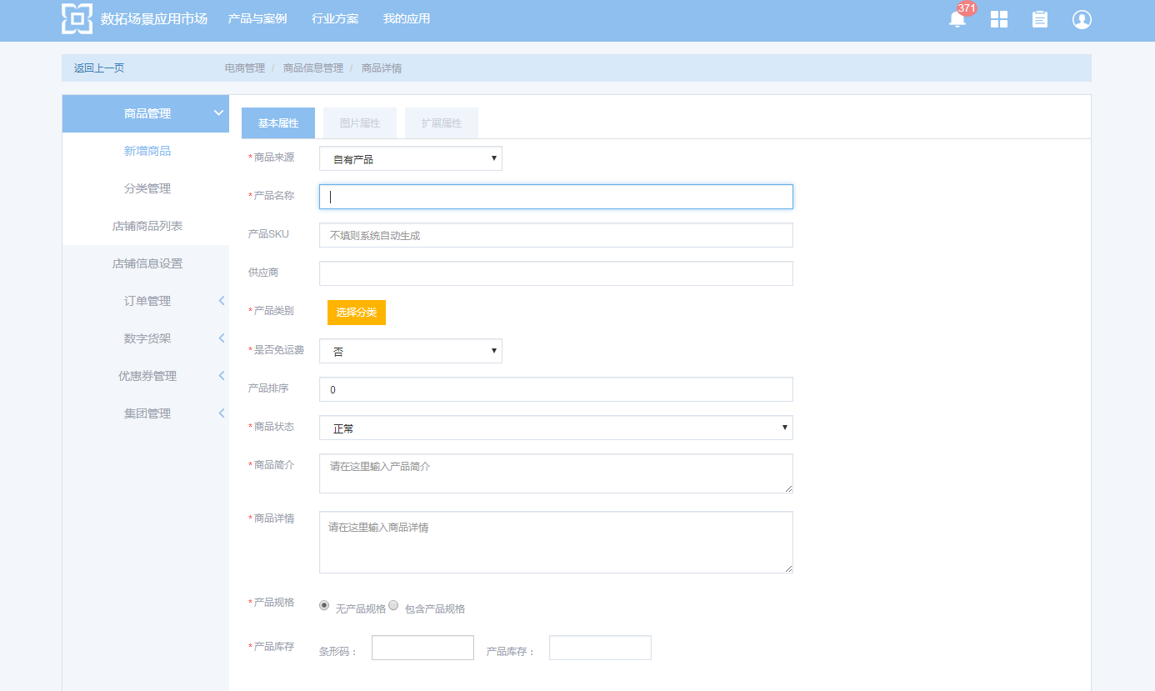
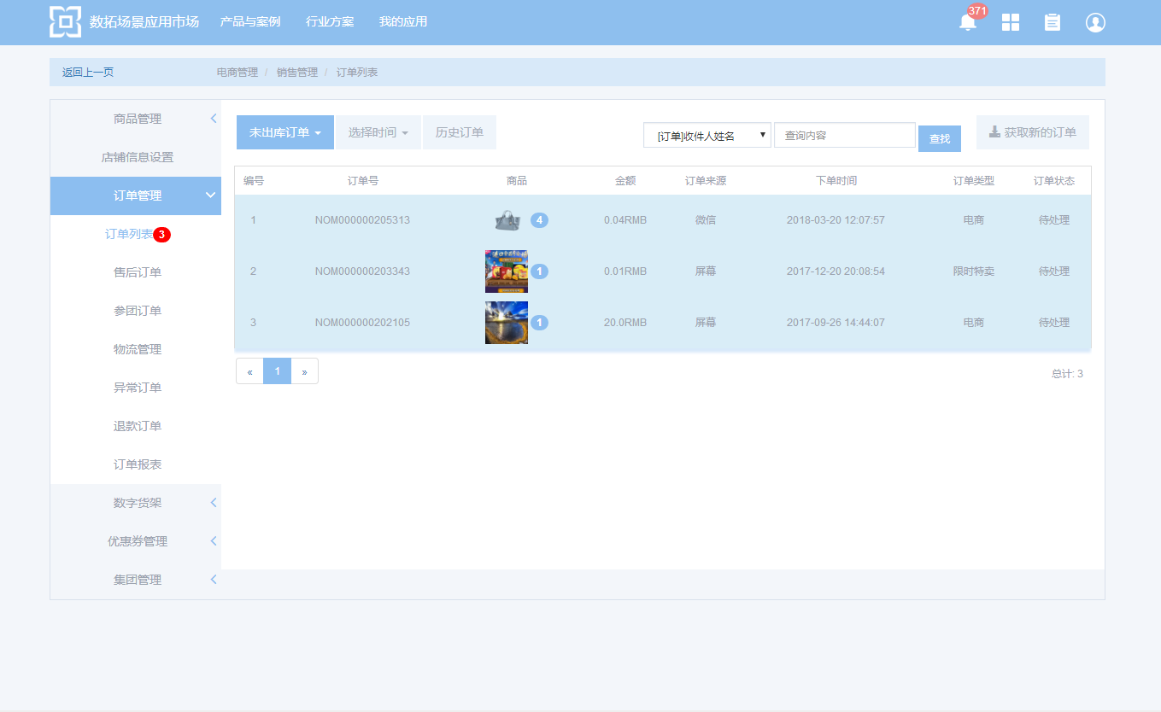
E-commerce Management
Own E-commerce Database
Mature E-commerce Processing system

Slide 20
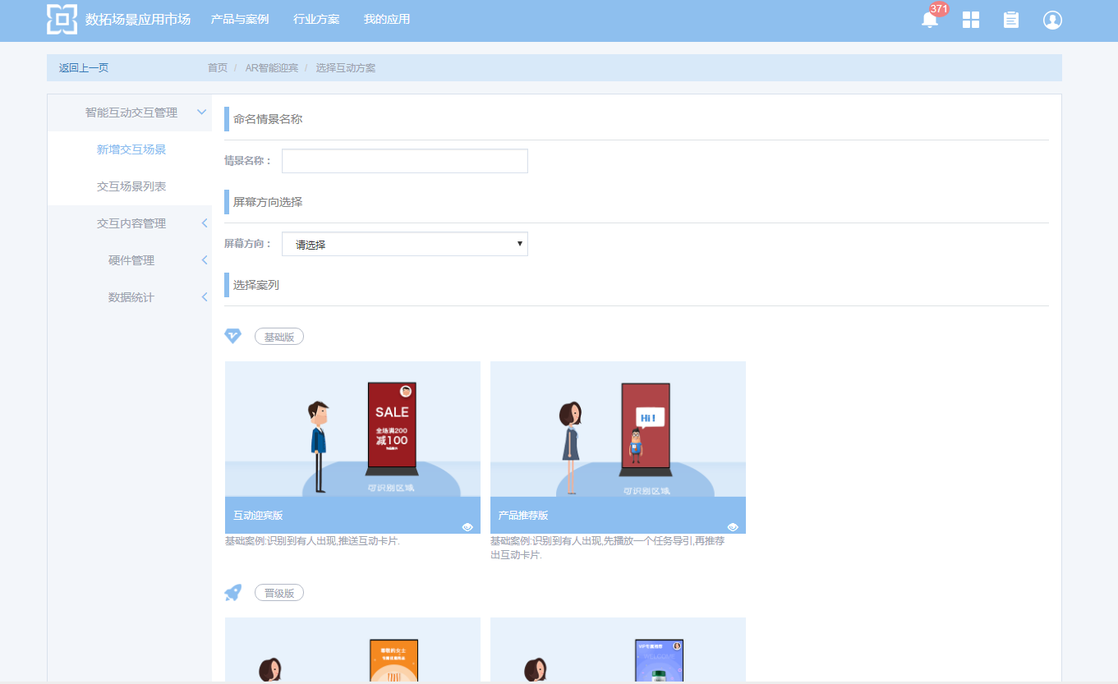
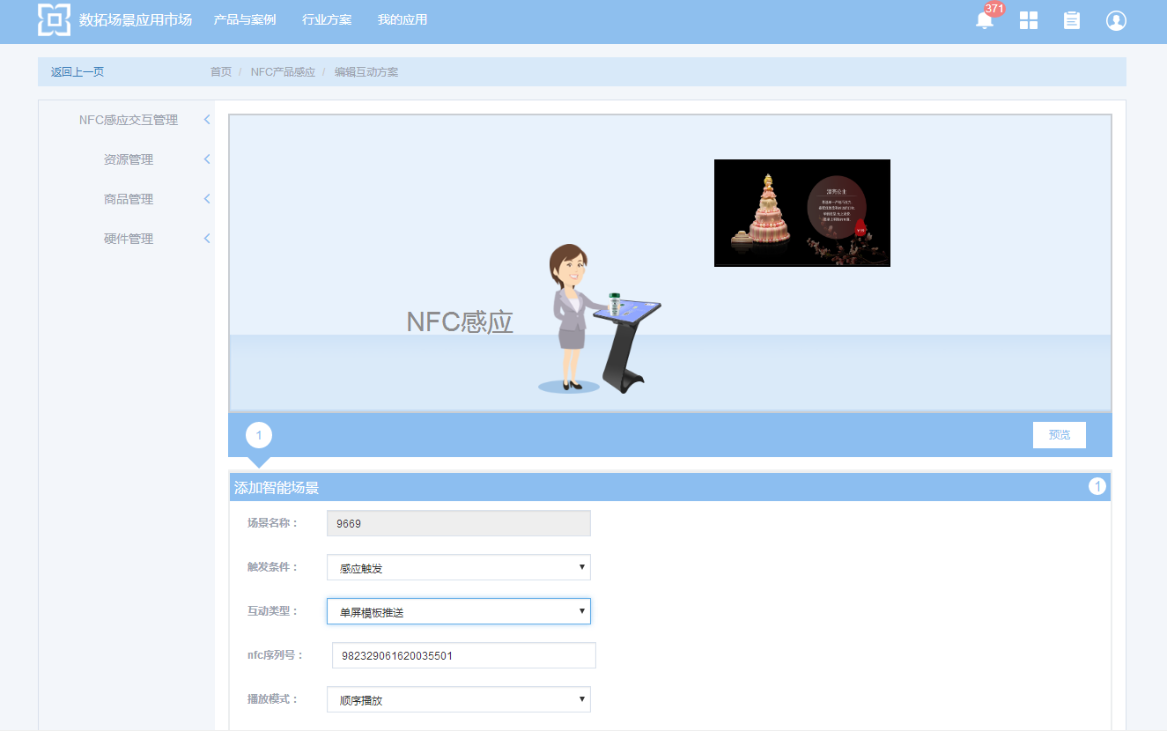
Intelligent Interaction Management
Camera Recognition Interaction
Product Identification Interaction Such As NFC

Slide 21
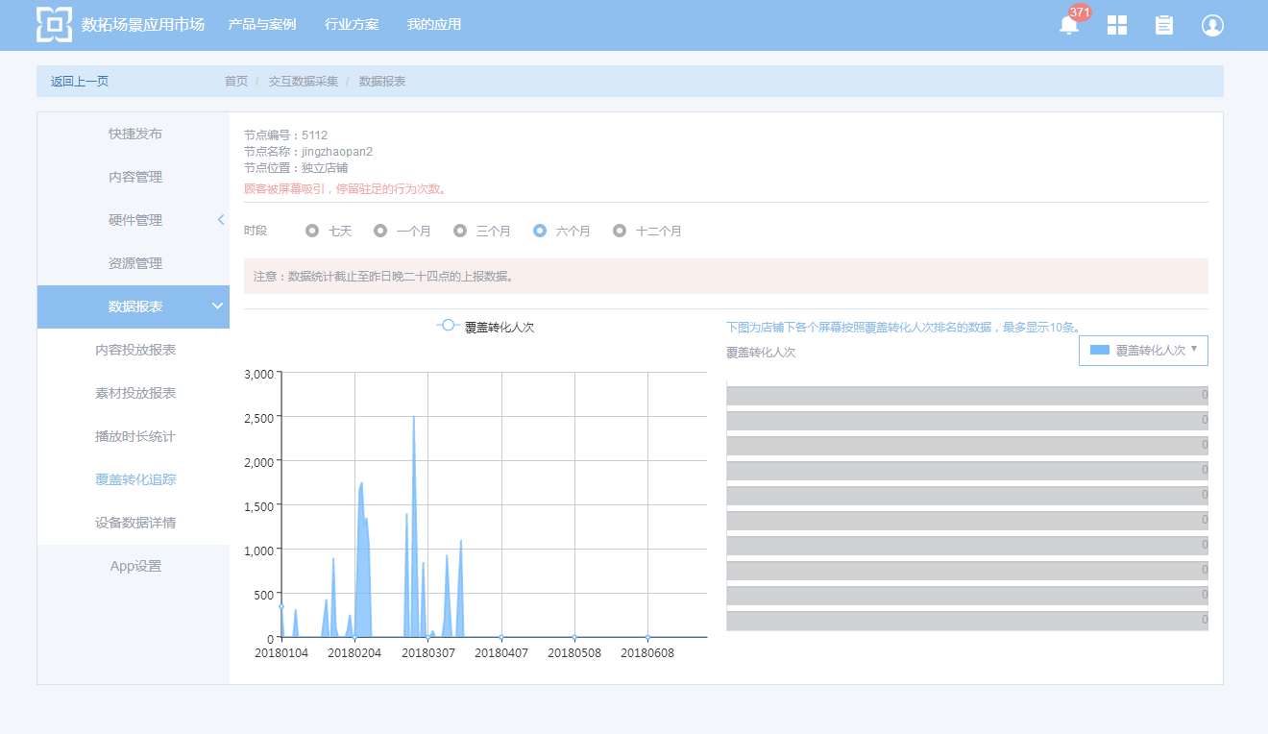
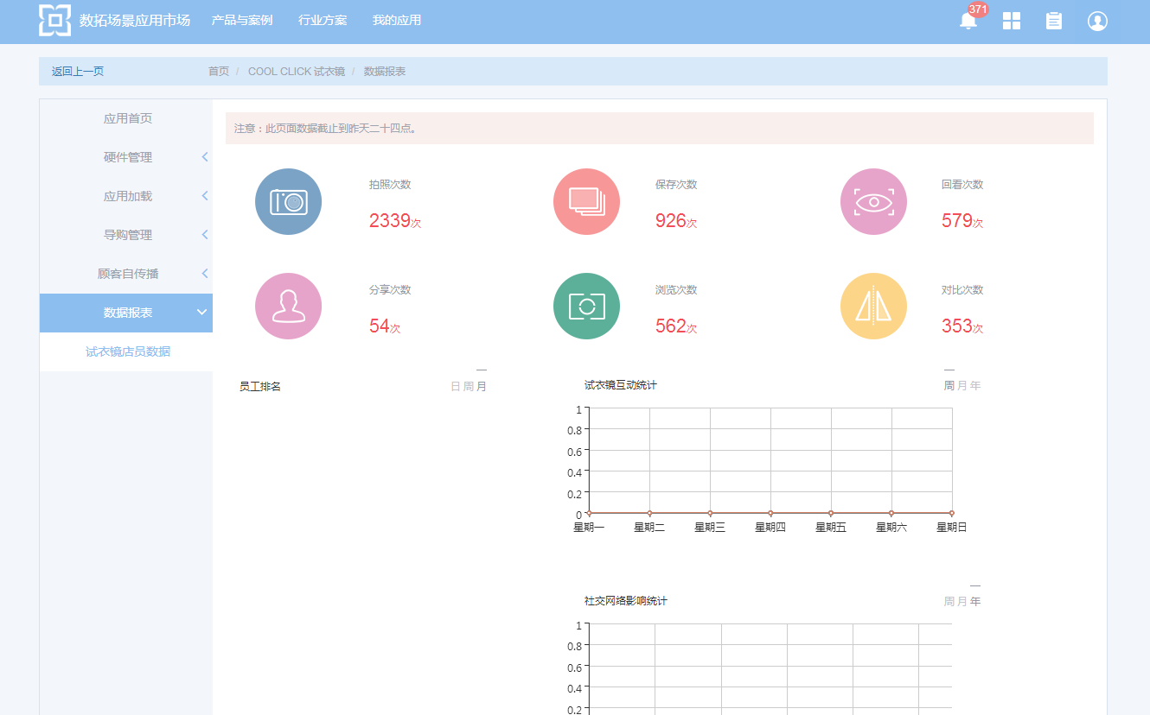
Data Management
Content And Crowd Cross Data
Consumer Behavior Data

Slide 22
PART TWO
Technical Advantages

Slide 23
Internet Service Engine
True open Internet architecture
The Digital Extension Platform is an intelligent Internet platform for business display. It supports standard data interfaces and can be interfaced with third-party systems, databases, and devices.
The digital extension platform has the ability of data acquisition and data analysis. The screen can collect environmental data, interaction data and user behavior through intelligent peripherals.
It is also possible to identify the user, analyze the potential needs of the user, and generate a user portrait.
Combined with the artificial intelligence expert system, it is possible to push the information most needed by the user to the front screen in real time.
Share Engine
(2 ways SNS data IO)
SNS Role
DB
Chat/Push Engine
(Data push policy & subs)
Subs DB
Auth Engine
(3A)
Data Sync Middle Layer
User DB
Application Logic Engine
(API data I/O basic logic)
Storage Engine
Knowledge Base Engine
Subs DB
Lookup/Route Entry
(Load balance)
Feature
Index Engine
Geo
Index Engine
Media Parser Engine
(Img parser & feature recognition)
Job/Task/Msg Queue
Track Engine
(Device/User/Event track)
(Device error collection)
Report generation
Network Monitor
(Monitor & Alert)
Track DB
Content Distribution Engine
(CDN for static &cache)

Slide 24












Intelligent Peripheral Access
Rfid
Bluetooth shift
NFC
Camera
WI-FI Probe
Infrared radiation
Gravity sensor
Touch query
Face recognition
Product identification
Hot zone analysis
Big data statistics
More possible with access, data and so on

Slide 25

Business Platform Docking
Digital Extension Service Platform
Open account docking interface
Addressing
server
AAA
sever
Business logic
server
database
Cluster
Storage service
Cluster
data analysis
And mining
Open service docking interface
Billing system docking interface
Message bus and
Middleware
CRM System
Digital Extension Service Portal
(load balancing)
Commodity database
monitor
server
Push in real time
server
CND
Distribution control
multimedia
Processing server
POS system
Management system web platform
Online marketing system
……

Slide 26





APP Function Iteration
Scenario application
Divide the industry, sub-scenarios, refine the requirements, provide targeted applications, and display screens more effectively 。
Poster machine
Cloud stitching
Cross-screen linkage
Application extension
The non-engineering development approach quickly responds to new demands in a standard APP approach to meet changing market demands.
Third-party application docking
Support for third-party applications, quickly integrate new features, and achieve unified management and control.
Poster machine
NFC Identification
Unmanned shelf

Slide 27
THANKS
2019 – 03 - 18

